Slide 1

CompactNet: Deep Learning Compression for Efficient Deployment
Model Compression
Ashish Ranjan, Prakalp Somawanshi*, Dr. Pradipta Biswas**
IISC, *DSML (IDA), **Associate Professor IISc

Slide 2
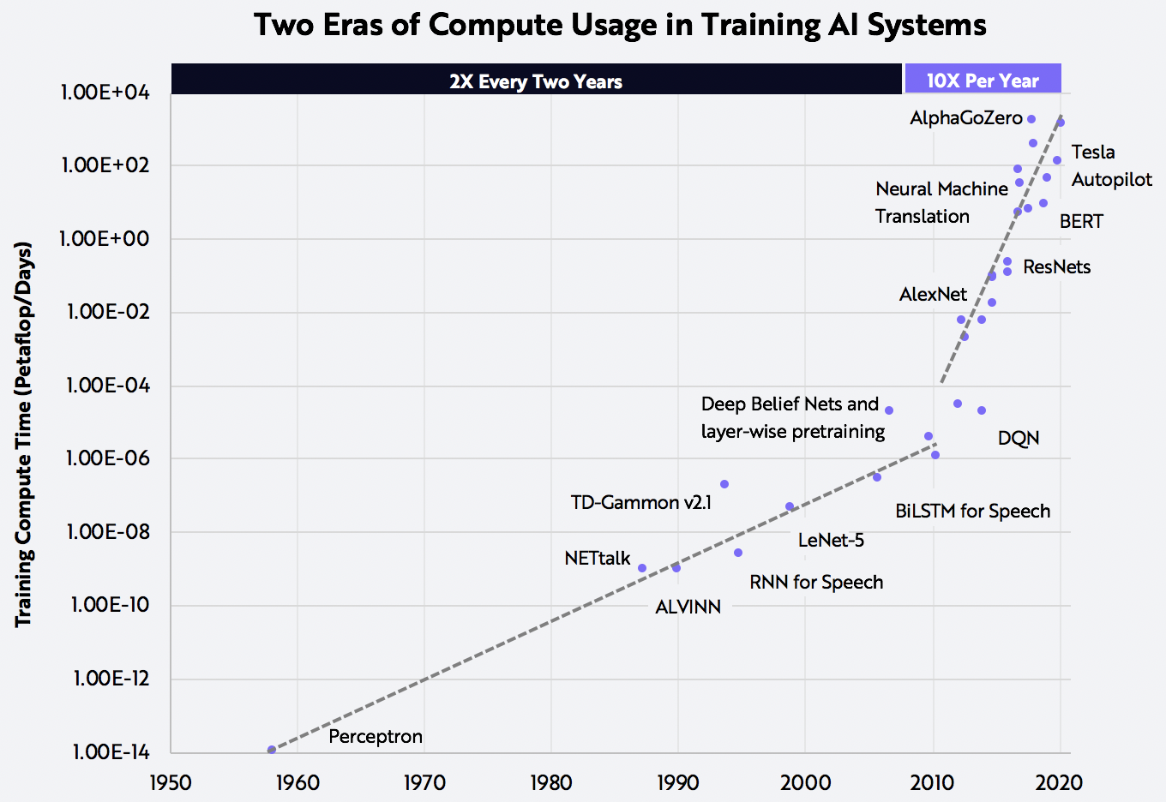
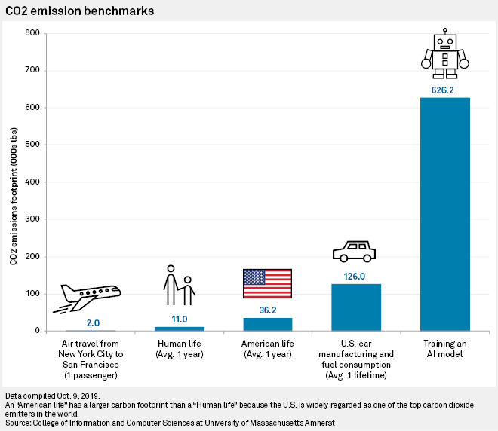

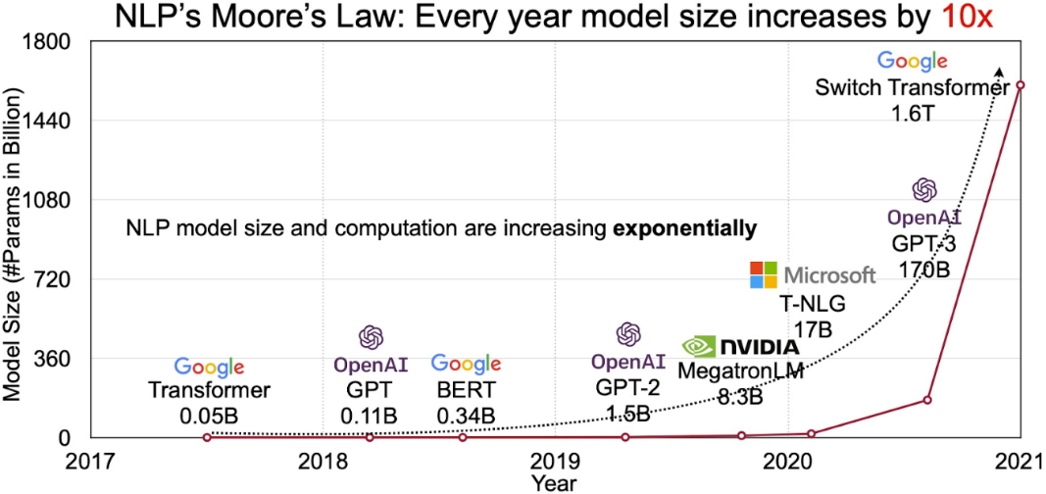
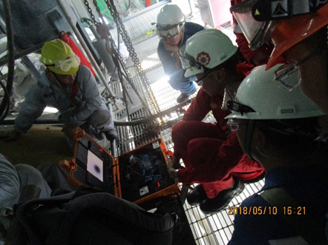
Cost
Environmental Impact
Cost of Training & Inferencing large models
CO2 Emission
Motivation
Space
Edge Deployments
Model Size
Standard-Eye

Slide 3
Objective:
Any deployment of Large Network (Convolutional or Transformer based) should go through compression process before deploying it to any business.
Large Model { Accuracy : a, Size: b, Inference time: c,
Power Consumption: d }
Small Model { Accuracy : a - 𝝙, Size: b - 𝜶, Inference time: c - 𝜷,
Power Consumption: d - 𝜸 }
Model Compression
Such a that 𝝙 is very small, 𝜶, 𝜷, 𝜸 are large

Slide 4
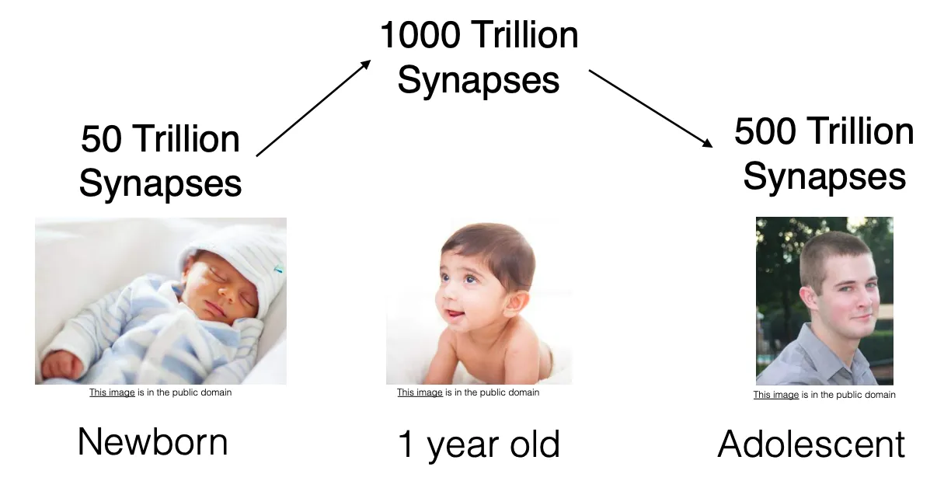
Model Compression!
“Model compression is the technique “shrinking” state-of-the-art neural networks and deploying in devices with low power and resources without compromising on the model’s accuracy.”
Deep neural networks are, in general, highly overparameterized.
Compressing or reducing in size and/or latency means the resulting models are both memory and energy efficient.
Notes:
Pruning, Quantization, Selective attention, Low-rank factorization, Knowledge distillation, Parameter Sharing, Pruning with Structured Sparsity, Multi-Task Learning.

Slide 5
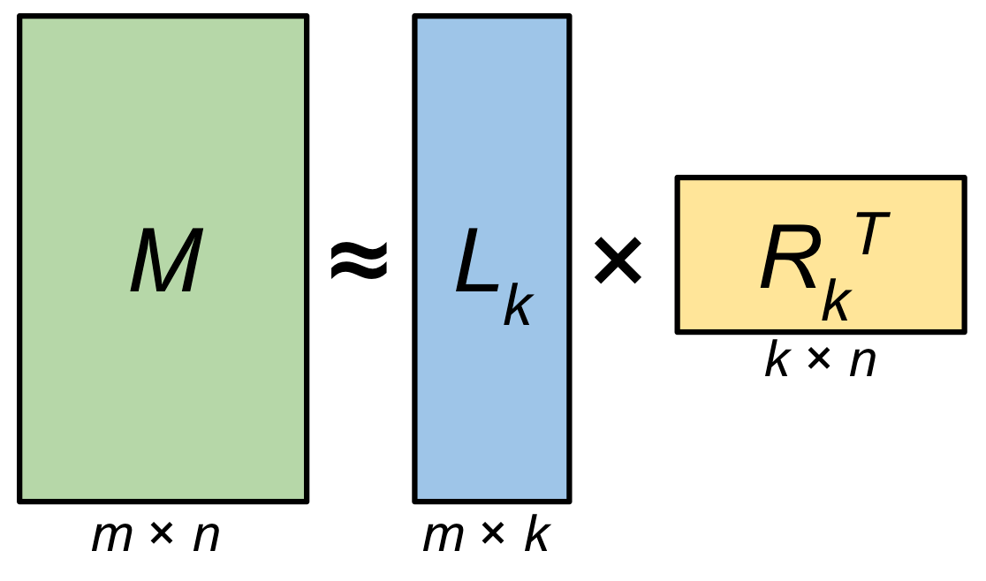
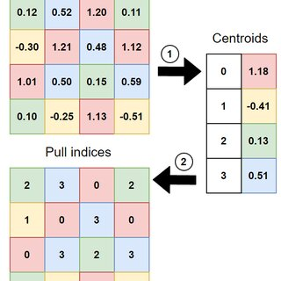
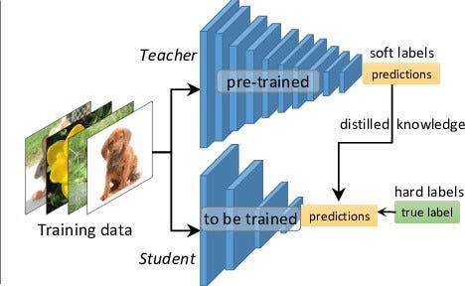
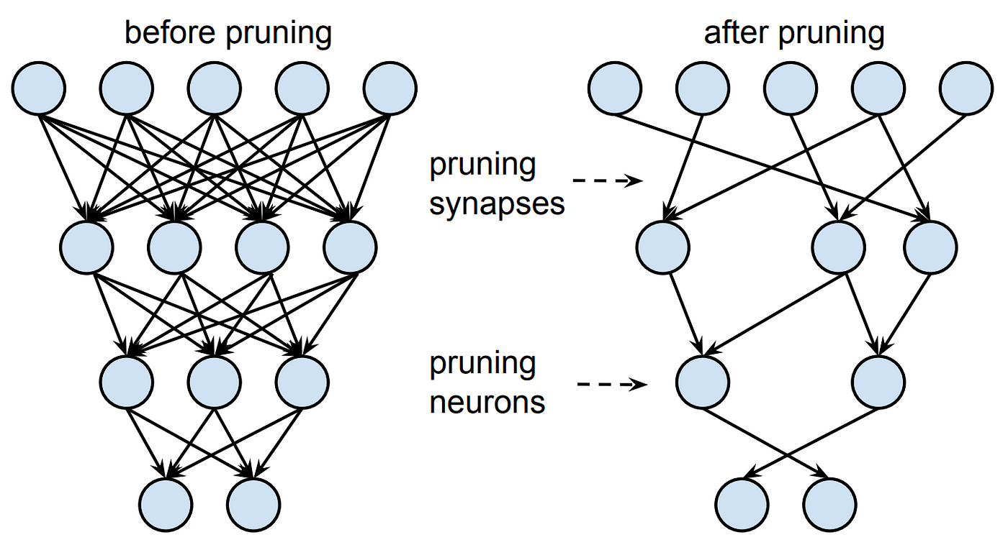
Different Compression Methods
Low-Rank Factorization
Quantization
Pruning
Knowledege Distillation

Slide 6
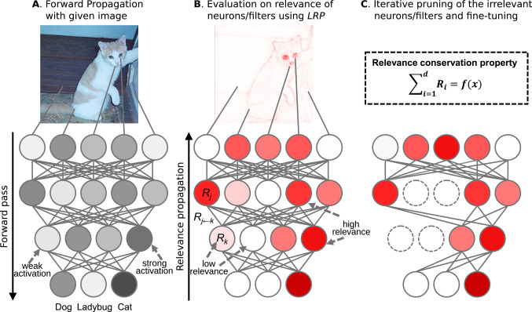
Model Pruning
Model Pruning is a technique to reduce the size of neural networks by eliminating less important weights or neurons, resulting in a smaller, more efficient model with minimal loss in performance.
Why Pruning?
Flexibility
Applicable to weights, neurons, channels, or layers.
Layer-specific optimization for targeted compression.
Performance Retention
Minimal accuracy loss with proper strategies.
Preserves model structure for easy integration.
Compatibility with Other Techniques
Combinable with quantization, distillation, etc.
Enhanced efficiency and effectiveness.
Scalability
Effective for large models with millions of parameters.
Supports incremental pruning for controlled compression.
Regularization Benefits
Implicit regularization improves generalization.
Helps prevent overfitting in large networks.

Slide 7
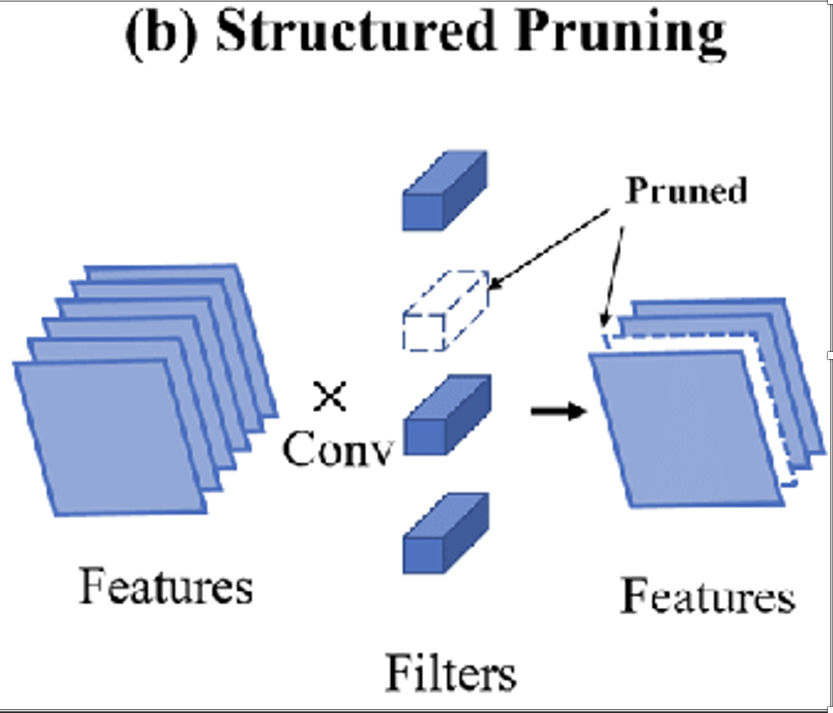
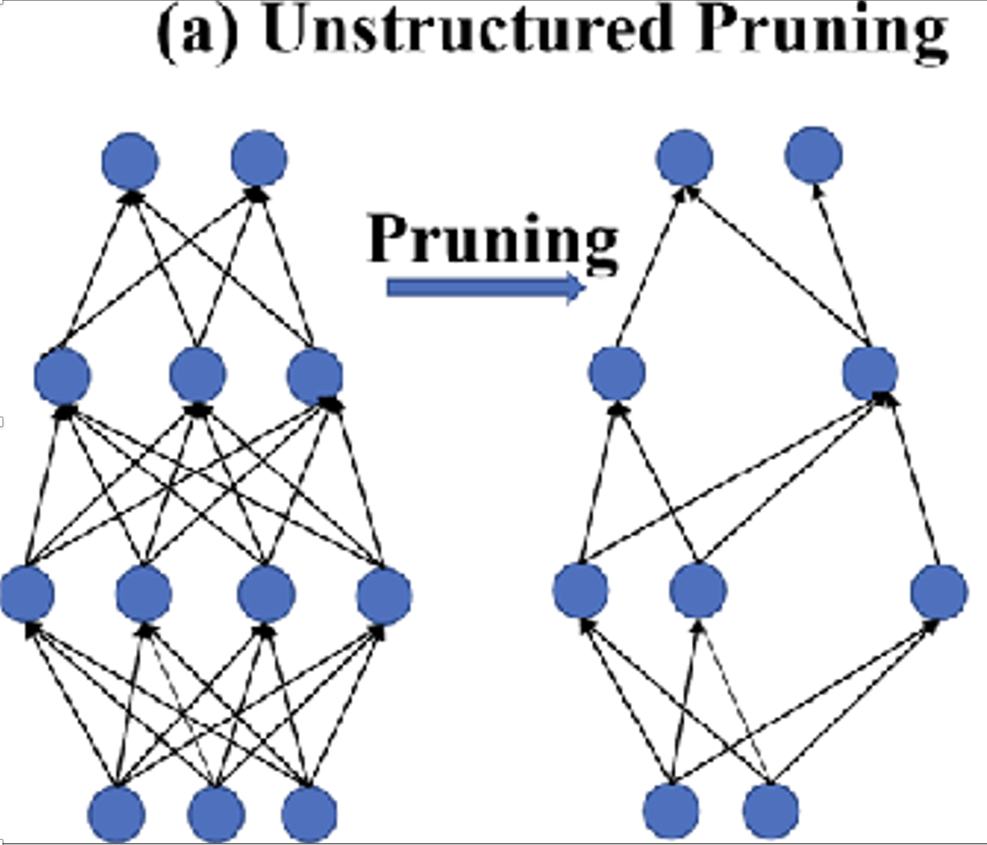
Types of Model Pruning
2. Unstructured Pruning
Removing individual weights within the neural network, leading to irregular sparsity patterns.
Weight Pruning: Removing individual weights.
• Magnitude-based Pruning: Pruning weights with the smallest magnitudes.
• Gradient-based Pruning: Pruning weights based on their gradients during training.
• Sensitivity-based Pruning: Pruning weights based on their sensitivity to the loss function.
1. Structured Pruning
Removing entire structures within the neural network for more predictable reductions in model size and computational requirements.
a. Neuron Pruning: Removing entire neurons.
b. Filter Pruning: Removing entire filters in convolutional layers.

Slide 8
USER INTERFACE

Slide 9
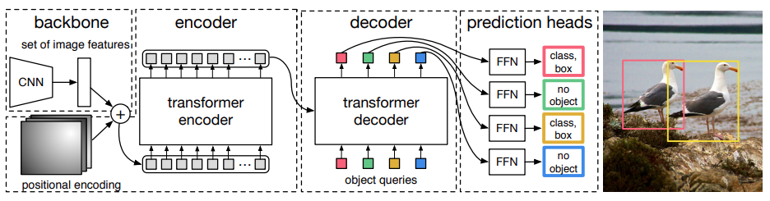
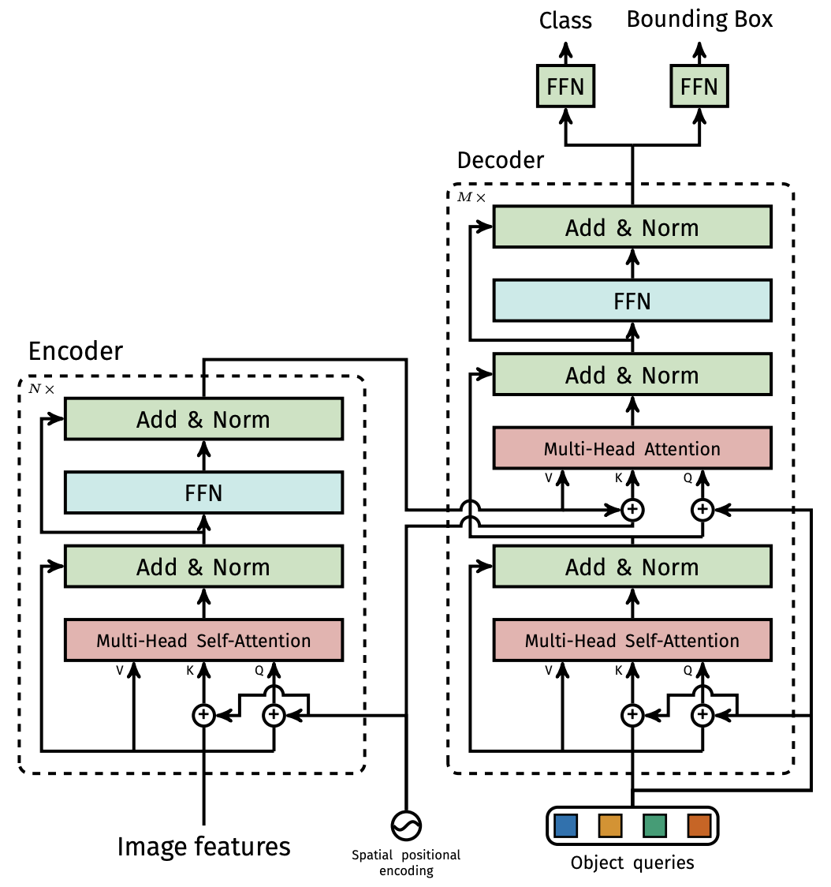
DETR (Target Model)

Slide 10
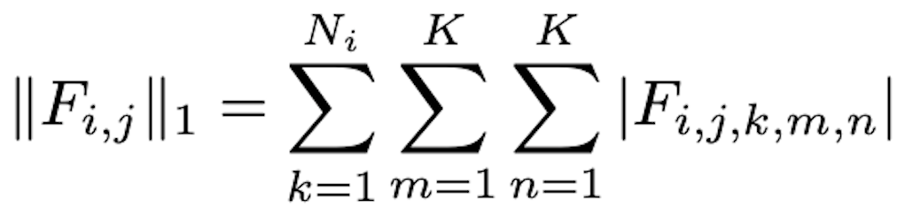
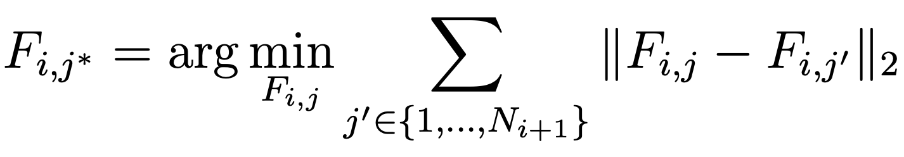
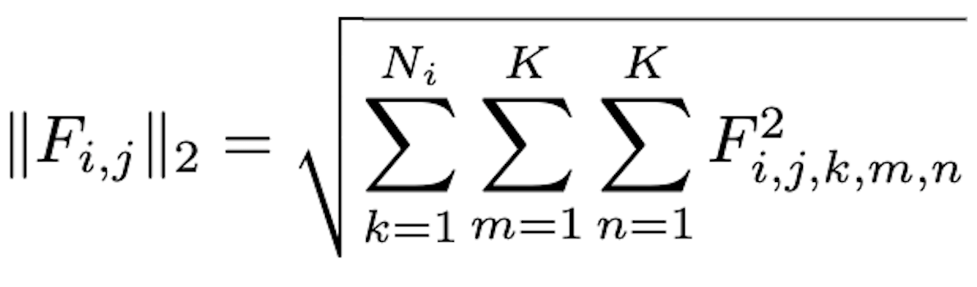
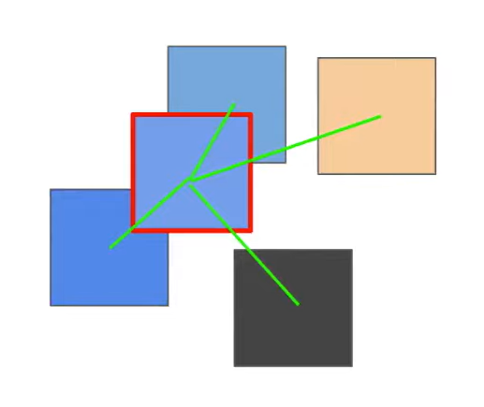
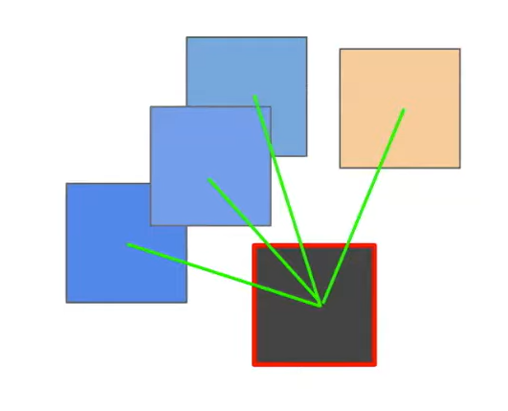
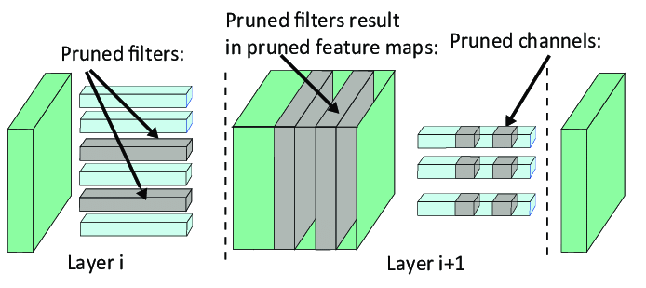
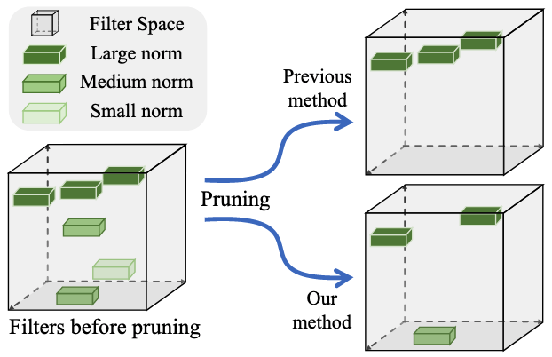
Pruning Techniques
Filter Pruning via Geometric Median (FPGM)
• Key Idea: Removes redundant filters by identifying and eliminating those that are similar to others using geometric median.
L1 and L2 Structured Pruning
• Key Idea: Removes Filters based on their Norm.
• L1:
• L2:

Slide 11
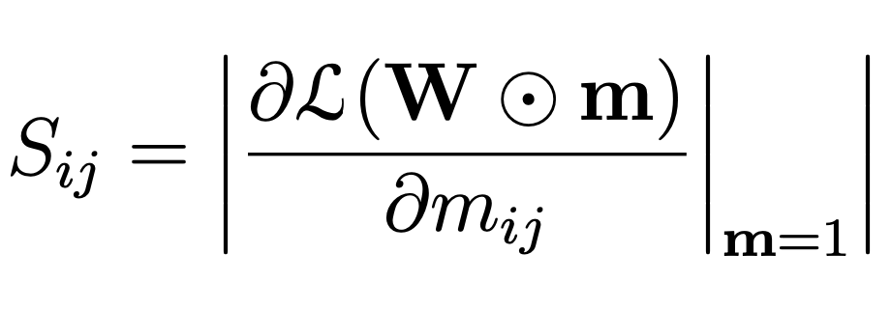
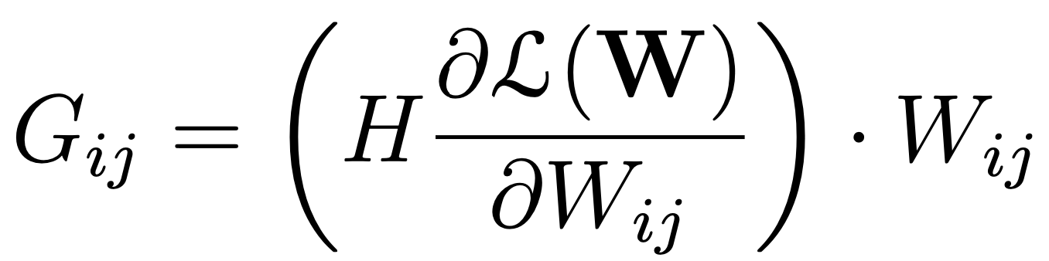
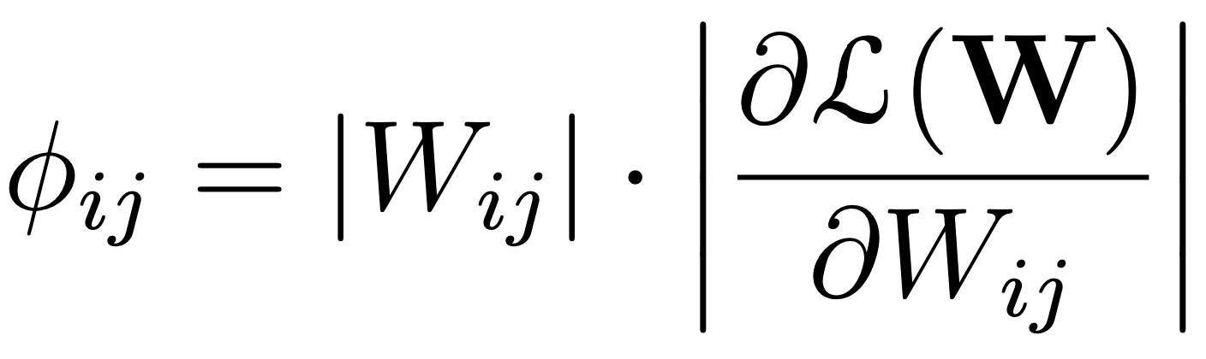
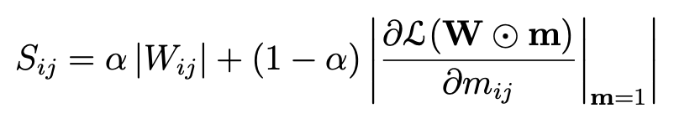
Pruning Techniques
SNIP: Single-shot Network Pruning based on Connection Sensitivity
• Key Idea: Prunes weights before training by assessing the sensitivity of connections
Gradient Signal Preservation (GraSP)
• Key Idea: Ensures the pruned network maintains gradient flow for continued effective training.
Synaptic Flow
• Key Idea: Preserves the flow of synaptic information during pruning to maintain the network’s trainability.
OurAlgo: Combined Gradient and Magnitude-Based Pruning
• Key Idea: Combines gradient-based and magnitude-based pruning to balance structural and functional significance.
.

Slide 12
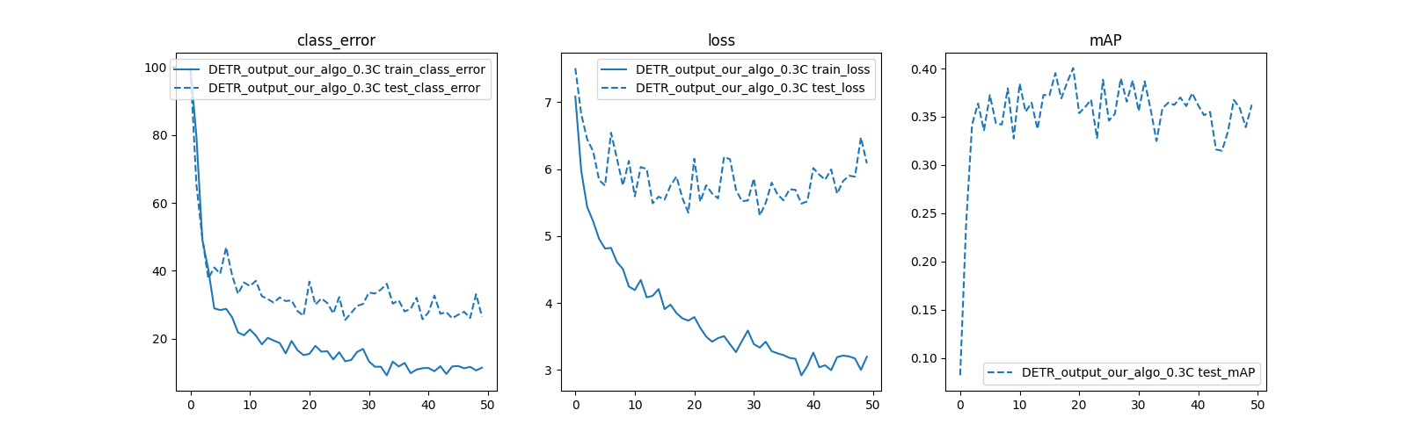
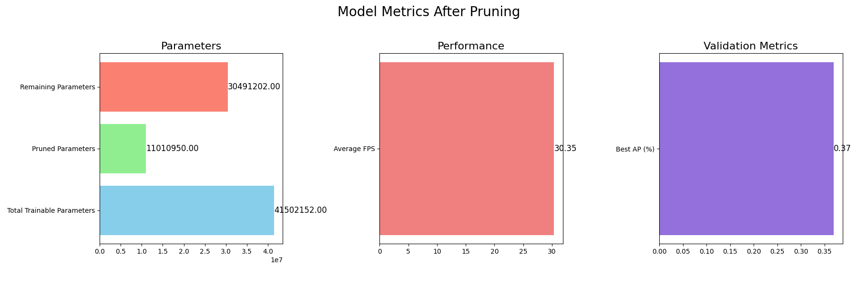

Experiment Setup And Results
Datasets
Classification: Utilized the CIFAR-10 dataset for both training and testing the models.
Object Detection: Employed a custom dataset of trucks formatted in the COCO format.
Segmentation: Used the Caravan dataset for the segmentation tasks.

Slide 13
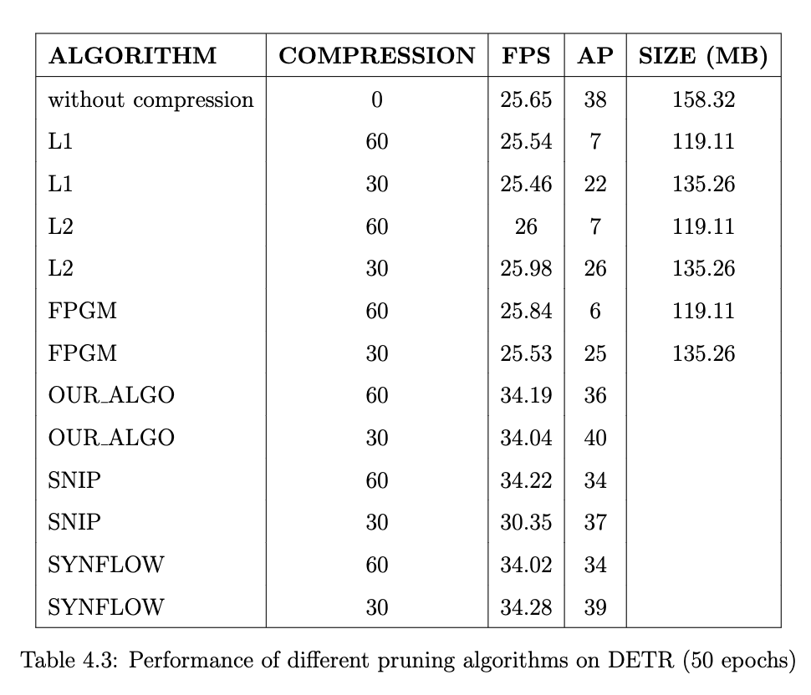
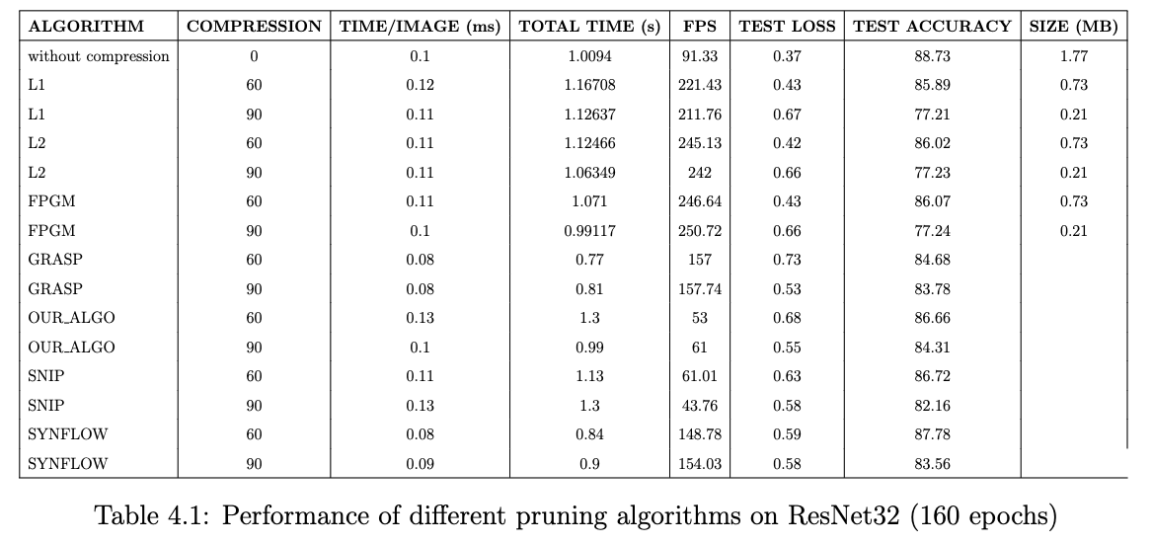
Results

Slide 14
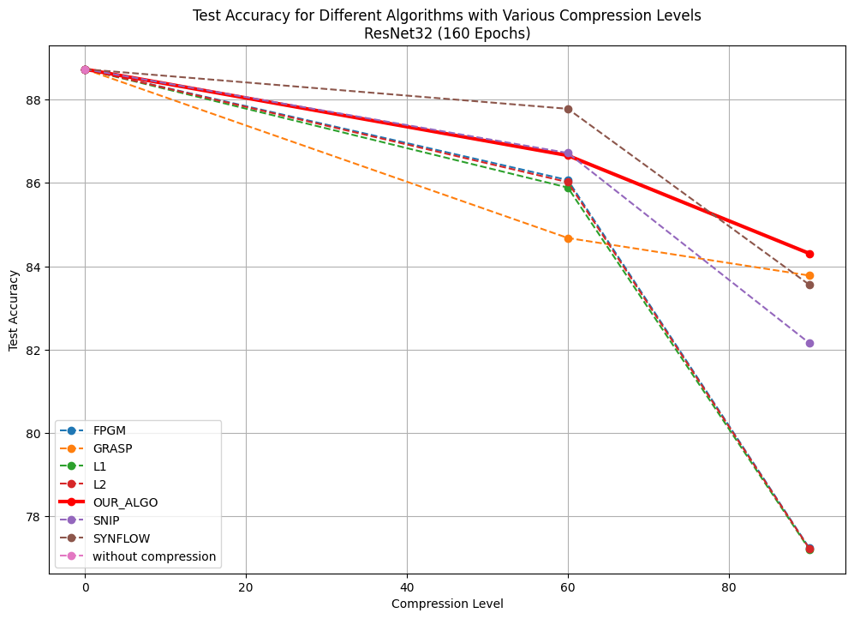
ResNet Results

Slide 15
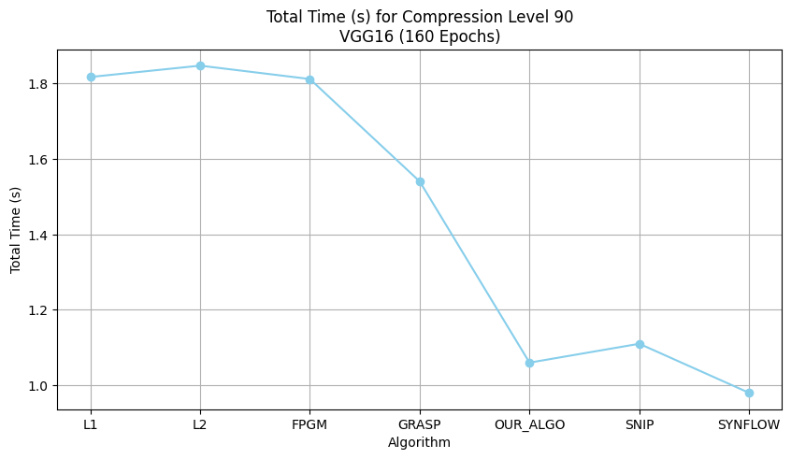
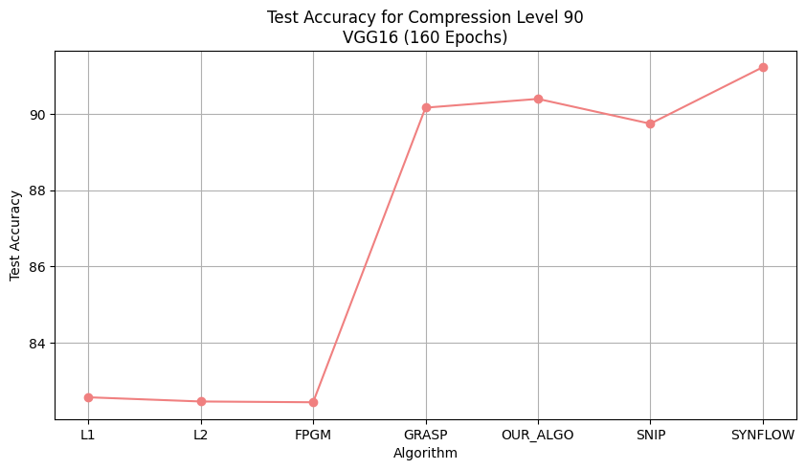
VGG Results

Slide 16
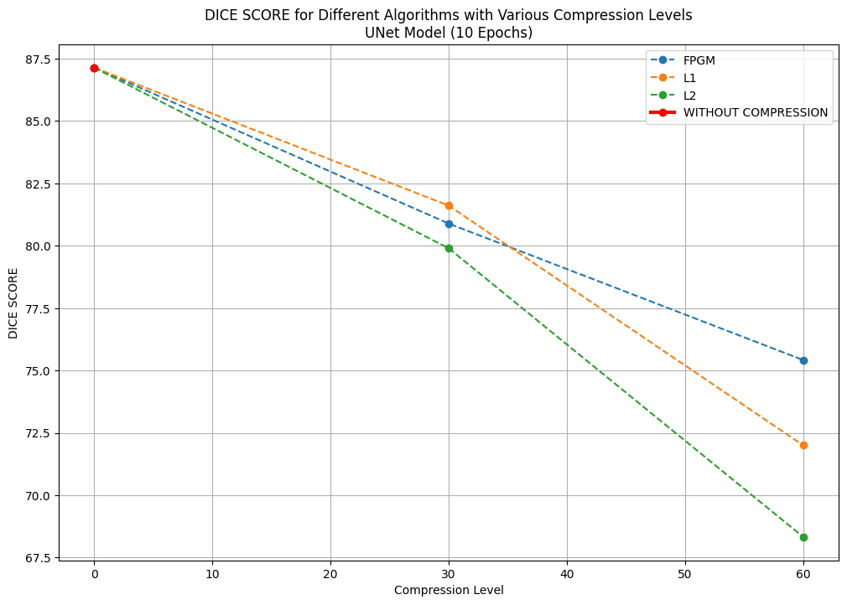
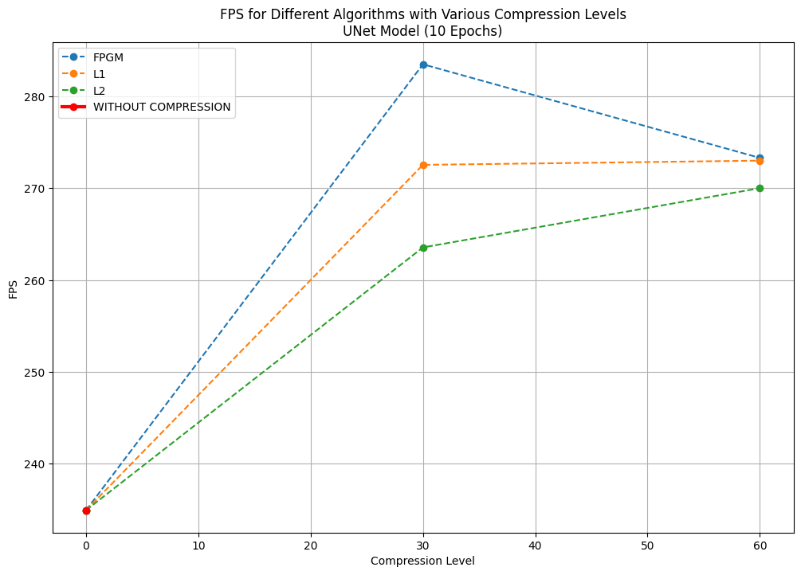
UNet Results

Slide 17
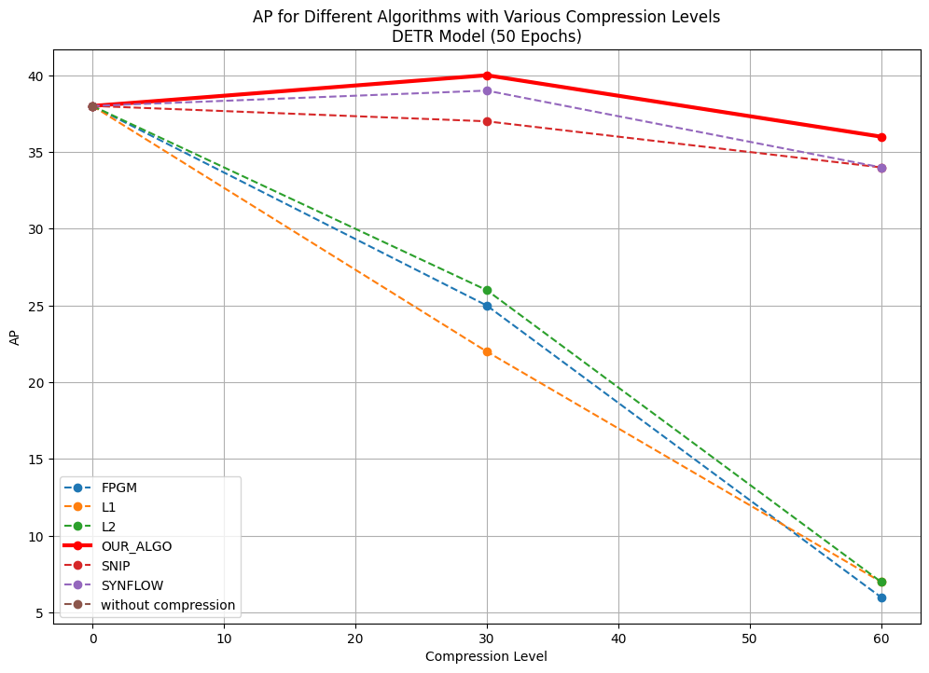
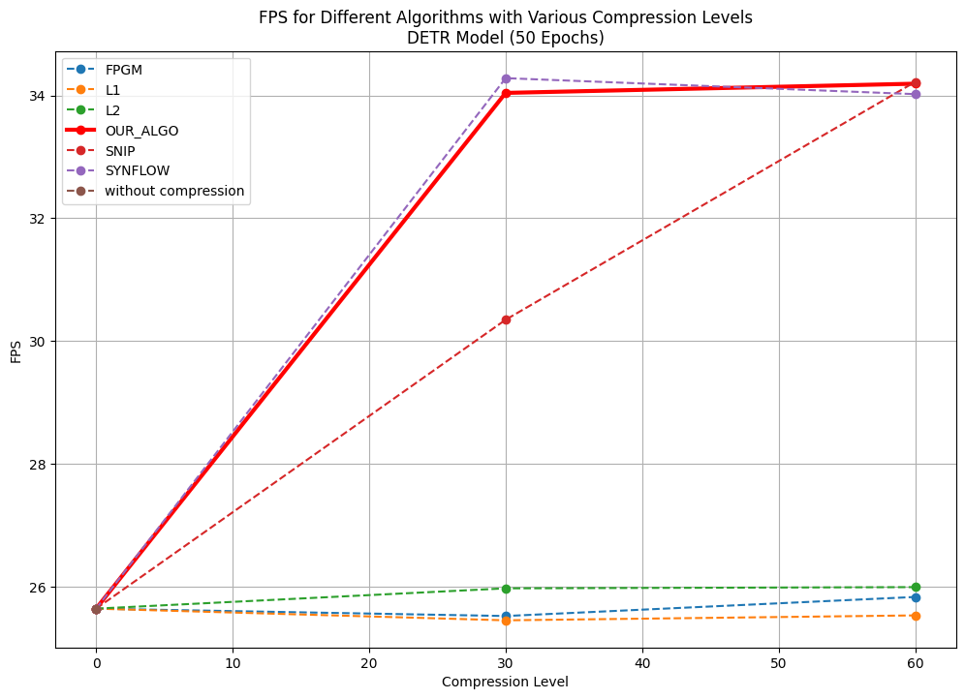
DETR Results

Slide 18
USER INTERFACE

Slide 19
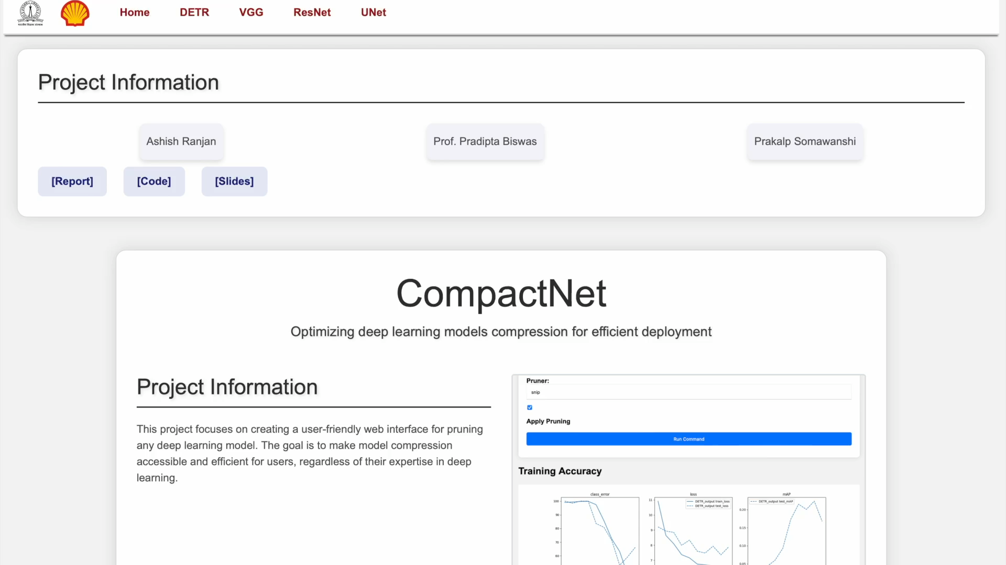
UI DEMO

